Slide 1
Define the following:
Community:
Population:
Ecosystem:
Habitat:
Interdependence
Biotic factors
What is a biotic factor?
List 4 examples and explain briefly how they affect a community.
Abiotic factors
What is an abiotic factor?
List 7 examples and explain briefly how they affect a community.
Competition
What are the different types of competition?
What do plants compete for?
What do animals compete for?
What happens to less successful species?
Ecology
Adaptation
What is adaptation?
What are the 3 types of adaptation?
Describe how one plant and one animal are adapted.
What is an extremophile?

Slide 2
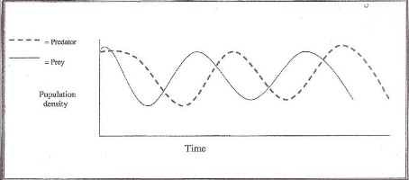
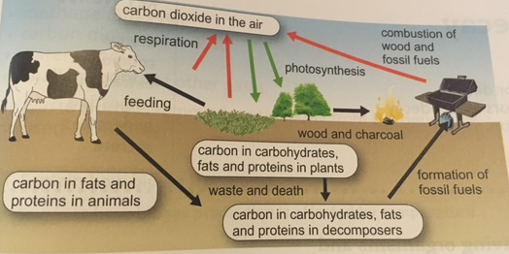
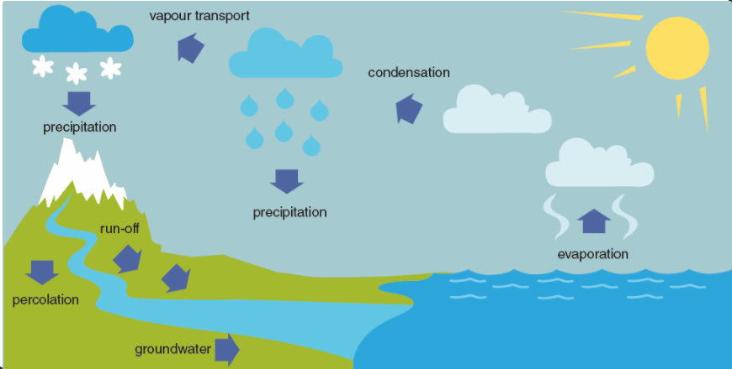
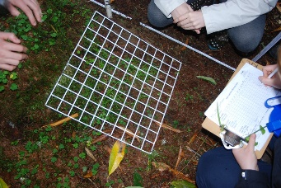
Levels of organisation
What does a food chain show? Label the organisms as producers, consumers, herbivore etc.
Use the graph to explain how a large and small predator population will each affect the number of prey.
Why are the predator cycles and prey cycles out of phase with each other?
Carbon cycle
Use the diagram to describe the carbon cycle.
Water cycle
Use the diagram to describe the water cycle.
Biodiversity
What is biodiversity?
Describe how each of the following can impact on biodiversity:
Waste management:
Deforestation:
Land use:
Global warming:
Required practical
Describe how you could use a quadrat to measure the population size of a common species in a habitat.

