Slide 1
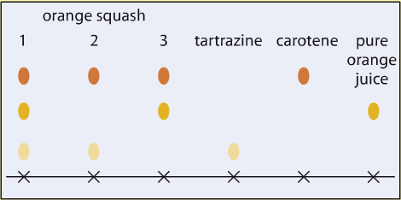
Solutions
5 a day revision
How does the law of conservation of mass apply to solutions?
Why can’t you filter a solute from a solvent?
What are the differences between solute, solvent and solution?
The chromatogram shows the results when different orange squashes and food colourings were tested using chromatography. Tartrazine is thought to make some people over-active. Which orange squash would be safe to give to an over-active person? Explain your answer.
What is a saturated solution?
@aegilopoides

Slide 2
Solutions
5 a day revision
How can you get salt from a mixture of rock and salt?
Describe some variables that affect solubility.
What equipment could you use in a lab to produce pure water?
What is chromatography?
When something dissolves is a chemical reaction happening? Explain your answer.
@aegilopoides

