Slide 1
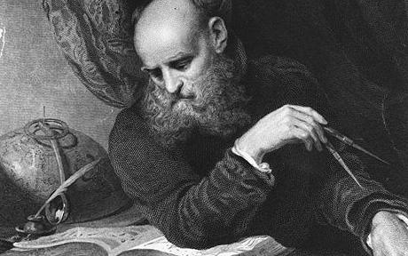
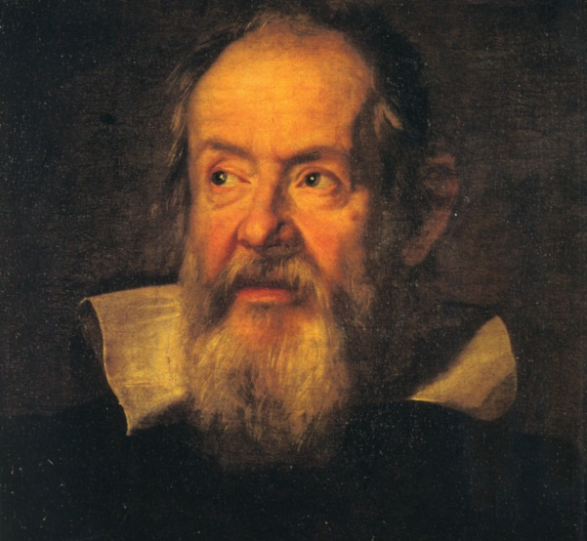
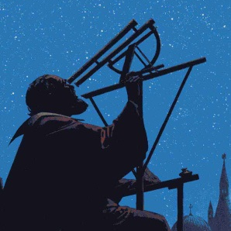
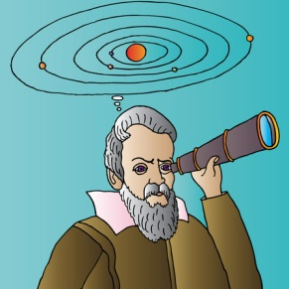
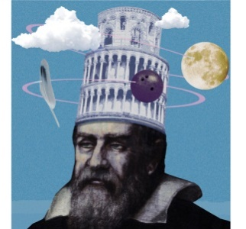
Sciencebook
Galileo Galilei
Galileo Galilei
Born: Died: Nationality:
About
About me
What I discovered about the solar system
Evidence for my ideas
What other people thought about my ideas

