Slide 1
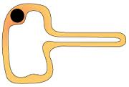
Draw and label a plant cell
How are leaves adapted for photosynthesis?
What type of cell is this?
Where is it found?
How is it adapted to it job?
What is the word/symbol equation for photosynthesis?
What is the function of:
cell wall
Nucleus
Cell membrane
Chloroplast
cytoplasm
Plant Biology
What are the tests for starch and glucose?
Starch:
Glucose:
Glucose is produced during photosynthesis. What does the plant use glucose for?
Describe an experiment to measure the rate of photosynthesis.
What are the independent, dependent and control variables?
What safety precautions would you take?

Slide 2
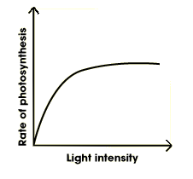
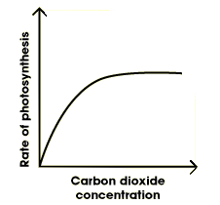
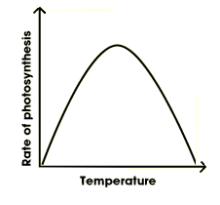
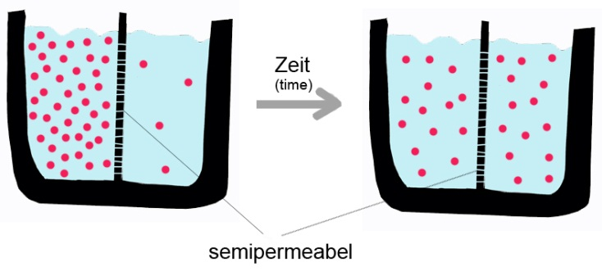
Explain how light, CO₂ and temperature are limiting factors of photosynthesis
Why do farmers want their plants to do as much photosynthesis as possible?
How can they control conditions to improve the growth of their plants?
Describe the path of water through the plant from the roots to the leaves.
Describe the function of xylem and phloem.
TMV and rose black spot are both diseases that affect plants. What are the causes, symptoms and effects of these diseases?
Plant Biology
What is diffusion?
How are osmosis and diffusion different?
How are diffusion and active transport different?
time
partially permeable membrane
What is active transport?
What is a partially permeable membrane?
Name 3 things that move in or out of cells:
What is osmosis?

