Slide 1
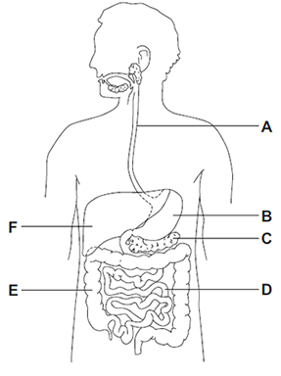
5 a day revision
Organisation
Human digestive system
Why might heart valves need to be replaced?
Name 3 parts of the digestive system that produce protease enzymes.
Label the diagram
What is the role of bile?
Explain the difference between mechanical and chemical digestion.
Describe the journey of a piece of food through the digestive system. You should refer to the relevant organs, enzymes and other digestive juices.

Slide 2
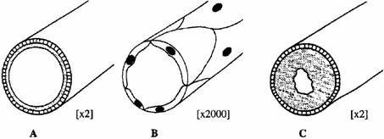
5 a day revision
Organisation
The heart and blood vessels
What is the function of the coronary arteries?
Explain why the left side of the heart is thicker.
What is meant by ‘ the heart is a double pump’.
Explain the role of valves in the heart for controlling blood flow.
Name each of the blood vessels in the diagram and explain how they are adapted to their function.

Slide 3
5 a day revision
Organisation
Cardiovascular disease
Suggest one advantage and one disadvantage of using an artificial heart to treat heart disease.
Describe how faulty heart valves can lead to poor blood circulation.
What is cardiovascular disease?
The risk of getting heart disease is affected by different lifestyle factors. Evaluate the data to decide who you think has the highest and lowest risk of suffering from heart disease. Explain your answer.
Compare the advantages and disadvantages of using statins and stents for treating heart disease.

Slide 4
5 a day revision
Organisation
Blood and circulation
Explain the role of valves for controlling blood flow.
Describe 3 ways in which red blood cells are adapted to carry oxygen.
List the four main components of blood and their functions.
Explain why blood is a tissue.
A comparison is made between blood taken from an artery in the leg and blood taken from a vein in the leg.
Explain two differences in the composition of the blood.

Slide 5
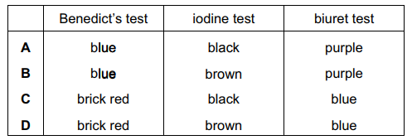
Organisation Food tests
5 a day revision
Describe the test for lipids (fats) and the results you would expect if it was positive.
Why might heart valves need to be replaced?
Which chemical would you use to test a sample for the presence of starch?
Describe how you would prepare a food sample to identify the food molecules it contains.
Four different food were tested for their composition. Which food contains protein but not sugar or starch?
Potato crops are grown for their carbohydrate content.
Describe how you could safely test the two species of potato to compare their
carbohydrate content.

Slide 6
5 a day revision
Organisation
Enzymes
Sketch a graph to show the effect of temperature on enzyme reactions.
Explain the lock and key model.
Define the terms:
Enzyme
Active site
An experiment is carried out using 2 samples of amylase. Sample 1 is first heated to 75°C and then cooled to 37°C.
Sample 2 is cooled to 10°C and then heated to 37°C.
Describe and explain the effect on enzyme activity.
What is a denatured enzyme and how can it happen?

Slide 7
5 a day revision
Organisation
Health, disease and lifestyle
Give examples of factors, other than disease, that can affect health.
Why might heart valves need to be replaced?
What a non-communicable disease? Give an example.
What is health?
What are risk factors? Give an example for a named disease.
Explain why non-communicable diseases can be costly.

Slide 8
5 a day revision
Organisation
Cancer
Why might heart valves need to be replaced?
Tumours can be malignant or benign.
What is the difference between the two?
What is a tumour?
What is cancer?
Describe how a tumour can spread to other parts of the body.
Explain why cancer survival rates have increased.

Slide 9
5 a day revision
Organisation
Plant tissues and organs
Explain how the upper epidermal tissue in a leaf is related to its function.
Why might heart valves need to be replaced?
Give 3 examples of:
Plant cells
Plant tissues
Plant organs
What is the difference between transpiration and translocation?
Explain how guard cells are adapted for gas exchange and controlling water loss in a leaf.
Describe the path taken by water through a plant from the root to the leaves. Explain why light intensity, temperature, air flow and humidity can all affect the rate of transpiration.

