Slide 1
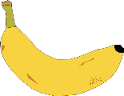
5 a day revision
Inheritance, Variation and Evolution
DNA and the genome
Draw a diagram of a cell and label where the DNA is found.
Why might heart valves need to be replaced?
What is the name of the structures that contain DNA?
What is DNA?
What is the difference between a gene and a genome?
Give 3 reasons why studying the human genome is important.

Slide 2
5 a day revision
Inheritance, Variation and Evolution
Reproduction
What are the advantages and disadvantages of asexual reproduction?
Why might heart valves need to be replaced?
Name 2 organisms that use each of the methods of reproduction that you named.
List the 2 types of reproduction.
Compare and contrast the 2 types of reproduction.
Explain why there is variation in the offspring produced from sexual reproduction and why this is important.

Slide 3
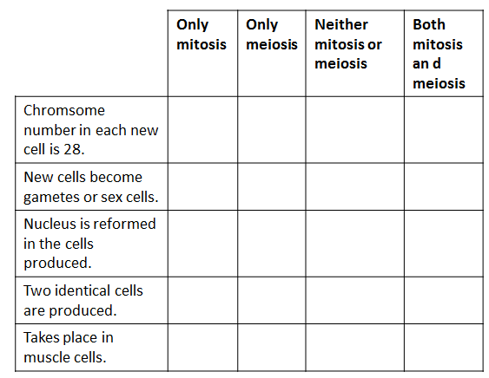
5 a day revision
Inheritance, Variation and Evolution
Meiosis
Why are gametes produced by meiosis and not by mitosis?
Why might heart valves need to be replaced?
How many cell divisions take place in meiosis?
Describe what happens in meiosis?
Compare mitosis and meiosis by referring to where each takes place and the kind of products that are made.
Every nucleus in the body cell of an elephant contains 56 chromosomes. Read the statements about cell division and put a tick in the correct box for each statement.

Slide 4
5 a day revision
Inheritance, Variation and Evolution
Sex chromosomes
Henry VIII blamed his wives for not producing a male heir, was he right?
Define the terms:
Dominant
Recessive
Use a Punnet square to show the inheritance of sex chromosomes.
Explain how some embryos develop into males?
Why are males more likely to have sex-linked diseases such as haemophilia?

Slide 5
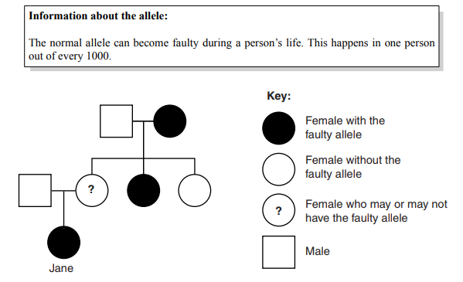
5 a day revision
Inheritance, Variation and Evolution
Genetic diagrams
Why might heart valves need to be replaced?
A man has polydactyly. His wife does not. This couple‘s children have a 50% chance of having polydactyly.
Draw a genetic diagram to explain why.
What is the difference between homozygous and heterozygous?
What is the difference between genotype and phenotype?
Albinism is an inherited condition in which pigment does not develop in the skin, hair and eyes. The albino allele is recessive. What are the chances of albino parents having a normal child? Draw a genetic diagram to explain your answer.
Jane has a faulty allele. A doctor concludes that Jane’s mother probably has the faulty allele too.
What evidence supports this conclusion?
Use evidence from the family tree and from information about the allele.

Slide 6
5 a day revision
Inheritance, Variation and Evolution
Inherited disorders
1 in 25 people in the UK are carriers of Cystic Fibrosis. Explain why carriers do not have the disease but their children might.
What is the difference between inherited disorders caused by dominant and recessive alleles?
What are different versions of the same gene called?
Give reasons for carrying out genetic tests on children and adults.
What are the implications of genetic screening programmes carried out by employers and insurance companies?

Slide 7
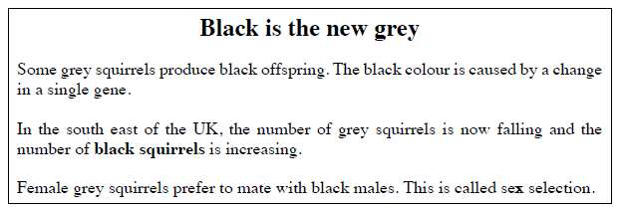
5 a day revision
Inheritance, Variation and Evolution
Evolution
What is extinction and what are the causes?
Outline the stages in natural selection.
What is a mutation?
Explain how changes in the gene pool lead to evolution.
Explain the recent increase in the number of black squirrels using ideas about natural selection.

Slide 8
5 a day revision
Inheritance, Variation and Evolution
Evidence for evolution
Explain how evidence from the fossil record provides evidence for evolution.
Describe how fossils may be formed.
What are fossils?
What are the problems with the fossil record?
What other evidence supports evolution?

Slide 9
5 a day revision
Inheritance, Variation and Evolution
Selective breeding
Describe the basic process of selective breeding.
Why might heart valves need to be replaced?
What is selective breeding?
Give 4 examples of selective breeding.
Explain why selective breeding can reduce the gene pool and why this is an issue.
Compare and contrast selective breeding and natural selection.

Slide 10
5 a day revision
Inheritance, variation and evolution
Genetic modification
Outline the steps in the process of genetic modification and give 2 applications.
State 5 reasons that make bacteria ideal for use in industrial and genetic processes.
Define genetic modification.
Wheat can be genetically modified to be resistant to weed killer. This helps farmers to keep their crop free of weeds, maximise the yield and earn more profit. However, some people are opposed to this idea. They think it is morally wrong to alter the DNA of living things (“playing God”).
Describe 2 other arguments against the genetic modification of wheat to be resistant to weed killer.
One example of genetic modification is the production of golden rice. Golden rice has a gene inserted that produces vitamin A. White rice does not contain vitamin A. Countries with people who eat mainly white rice have high levels of blindness due to a lack of vitamin A.
Suggest why people in these countries may be more in favour of the genetic modification of organisms than people who live in the UK.

Slide 11
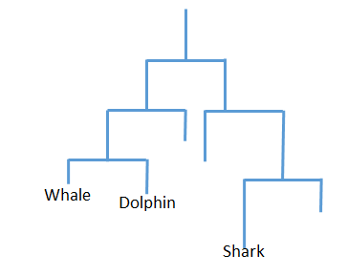
5 a day revision
Inheritance, variation and evolution
Classification of living organisms
Who proposed the 3 Domain system of classification and what are the 3 domains?
Why might heart valves need to be replaced?
What is classification?
The Linnean system divides organisms into kingdoms and smaller subgroups – what are the subgroups?
In the Binomial system, humans are known as Homo sapiens – explain what this means.
Explain how this evolutionary tree shows that whales and dolphins are more closely related to each other than either are to sharks.

