Slide 1
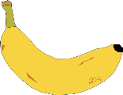
Inheritance
5 a day revision
What happens during fertilisation?
Why do gametes contain half the amount of genetic information?
Where in the cell is genetic information found?
How are gametes adapted to their functions?
What is a mutation?
@aegilopoides

Slide 2
Inheritance
5 a day revision
Why do siblings look similar?
Explain why children look like their parents.
What is variation?
What causes it?
Decide whether the following characteristics are caused by genes, environment or both:
naturally blue eyes, having a scar, naturally curly hair, being very tall, having a cold, being able to speak French
What is selective breeding?
@aegilopoides

