Slide 1
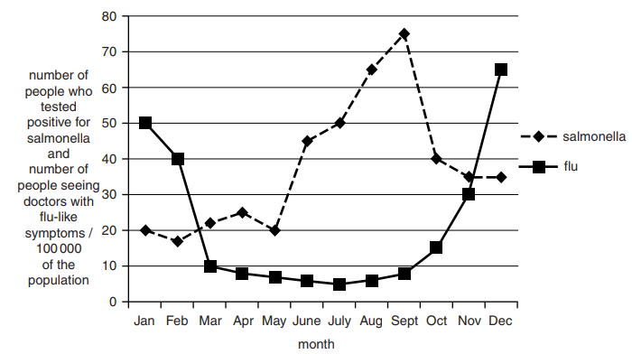
5 a day revision
Infection and response
Communicable disease
Why might heart valves need to be replaced?
Describe the main ways in which pathogens spread.
Explain the difference between an epidemic and a pandemic.
Give four examples of pathogens.
What is a communicable disease?
It is
It is thought that the way diseases are spread will affect when people are morel likely to get the disease.
Flu is spread by airborne droplets, usually indoors or on crowded buses or trains.
Salmonella is spread through food that is not cooked thoroughly or stored at incorrect temperatures.
Explain how the way microorganisms are spread can explain the patterns in the graph.

Slide 2
5 a day revision
Infection and response
Viral , fungal and protest disease
Rose black spot is a fungal plant disease. Describe how it is treated.
Why might heart valves need to be replaced?
For each of the viral diseases you named, explain how they are spread.
Give examples of viral diseases in animals and plants.
In some countries, pools of water are sprayed with insecticides to reduce the spread of malaria. Explain why this works.
Explain why it is more difficult to treat viral diseases compared to bacterial diseases.

Slide 3
5 a day revision
Infection and response
Bacterial disease
Why might heart valves need to be replaced?
Give 4 methods of reducing the spread of disease.
What are the symptoms of Salmonella food poisoning?
How do bacteria make us feel ill?
Why has it become more difficult to treat Gonorrhoea?
Some strains of the bacterium E. coli can make us ill if they enter our body
Bacteria of this strain can enter the body on contaminated food.
A person may develop symptoms of food poisoning if the number of bacteria of this strain in the stomach is ≥$1 x {10}^{4}$
A single bacterium of this strain can reproduce itself every 20 minutes in optimum conditions.
A piece of food is contaminated with 200 bacteria of this strain. It is left at room temperature for 2 hours. Jenny concludes that anybody who eats this piece of food will get food poisoning. Is she correct? Explain your answer.

Slide 4
5 a day revision
Infection and response
Fighting disease
List 4 ways that the body stops microbes from entering.
Describe phagocytosis.
Define: pathogen, antibody, antigen.
Describe the different ways in which white blood cells protect us from infectious diseases.
Smoking can damage and paralyse cilia. Explain why smokers are more susceptible to respiratory infections.

Slide 5
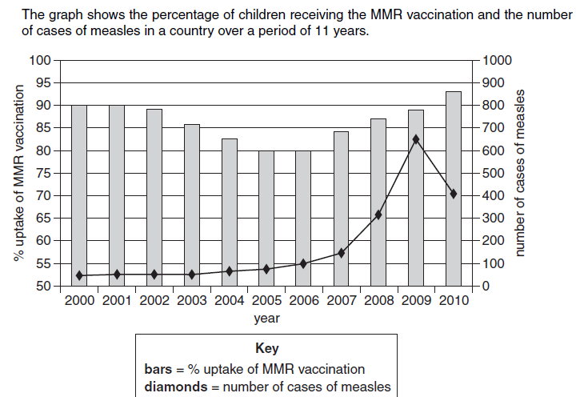
5 a day revision
Infection and response
Vaccination
Explain why new flu vaccinations are needed each year.
What is a vaccine?
Explain what is meant by herd immunity.
The MMR vaccination provides protection against measles. Measles is a disease caused by a microorganism.
Calculate the percentage increase in the number of cases of measles between 2006 and 2009.
How does the graph suggest an explanation for the increases in cases between 2006 and 2009?
Explain why vaccinations can never be completely risk free.

Slide 6
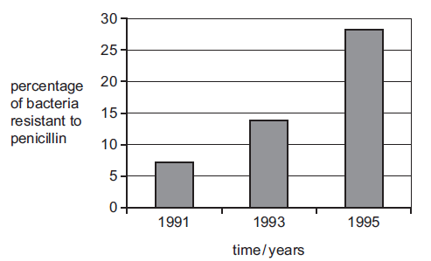
5 a day revision
Infection and response
Drugs
What is antibiotic resistance?
What are painkillers?
What is an antibiotic?
The graph shows the change in percentage of bacteria that were resistant to the antibiotic penicillin between 1991 and1995.
What are the implications of antibiotic resistance for medicine?
a) Describe the trend shown by the graph between 1991 and 1995.
b) Explain how a population of antibiotic resistant bacteria can develop.

Slide 7
5 a day revision
Infection and response
Drug trials
Why are drugs first tested on healthy people?
Describe two types of clinical trial.
What is meant by efficacy of a drug?
Why is a double blind trial considered to generate the most reliable results?
When testing a drug on humans, a placebo is sometimes used. Explain why placebos are important, and how ethical issues with using placebos are overcome.

