Slide 1
5 a day revision
Homeostasis and Response
Homeostasis
Explain why internal conditions need to be regulated.
Why might heart valves need to be replaced?
Give 3 examples of conditions that need to be regulated.
Define homeostasis.
State the 3 main components of an automatic control system.
Explain what negative feedback means.

Slide 2
5 a day revision
Homeostasis and response
The nervous system
What are the 3 types of neurone that are found in the body?
Why might heart valves need to be replaced?
What are the two parts of the nervous system?
Name two examples of effectors in the body.
What makes up the central nervous system and what does it do?
Predict what might happen if the myelin sheath around your nerve cells began to break down.

Slide 3
Homeostasis and response
Synapses and reflexes
5 a day revision
Describe how an impulse is transmitted across a synapse.
Describe the pathway of a reflex from stimulus to effector.
What is a synapse?
i) An impulse takes 0.02 seconds to pass from the finger to the spinal cord, a
distance of 1.5m. Calculate the speed of the impulse. Show your working.
ii) Although the total distance the impulse travels in the reflex arc is less than 3m, the time taken is more than 0.04 seconds. Suggest why the time taken is
more than expected.
Identify two features of a synapse that mean that impulses can only travel in one direction.

Slide 4
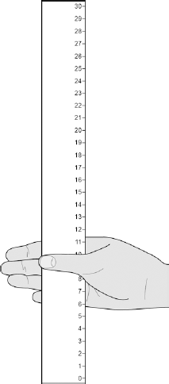
5 a day revision
Homeostasis and response
Investigating reaction time
Why might heart valves need to be replaced?
Reaction time can be investigated with the ruler drop experiment. Give 2 variables that should be controlled in the experiment.
What factors could affect reaction time?
Why are reflexes important?
Describe any safety procedures you would carry out with the ruler drop experiment.
Suggest why a computer test may be a better method for measuring reaction time.

Slide 5
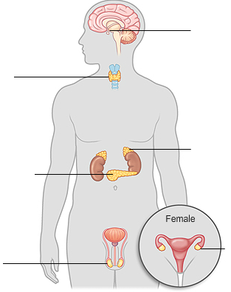
5 a day revision
Homeostasis and response
The endocrine system
Give 3 differences between hormonal and nervous responses.
Label the glands.
Why might heart valves need to be replaced?
A
What are hormones?
B
D
C
Explain why the pituitary gland is referred to as the master gland.
E
F
How does adrenaline prepare the body for ‘fight or flight’?

Slide 6
5 a day revision
Homeostasis and response
Control of blood glucose
Why might heart valves need to be replaced?
Name the hormones involved in the control of blood glucose levels.
What is the name of the organ that produces hormones that control blood glucose levels?
What is diabetes?
Describe the body's response when blood glucose concentration is too high.
What is the difference between Type I and Type II diabetes? How are they treated?

Slide 7
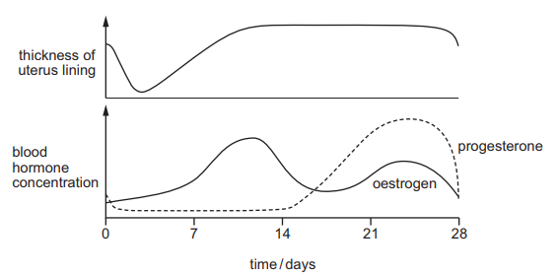
5 a day revision
Homeostasis and response
Hormones in reproduction
Why might heart valves need to be replaced?
State the 4 hormones that control the menstrual cycle.
What are the 4 stages in the menstrual cycle?
What is the menstrual cycle?
State the organs that release each of the 4 hormones.

Slide 8
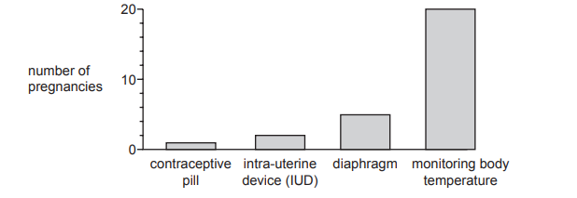
5 a day revision
Homeostasis and response
Contraception
Why might heart valves need to be replaced?
What is the advantage of using long-term contraception methods instead of taking a contraceptive pill every day?
Explain how a contraceptive pill works.
Give 2 examples of barrier methods of contraceptives.
Using information from the graph, the method of contraception which is least effective is:
A barrier
B chemical
C natural
D surgical
Explain why IUDs could be considered to be unethical.

Slide 9
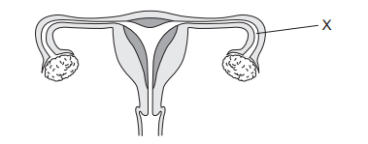
5 a day revision
Homeostasis and response
Infertility
Explain why FSH and LH are given as fertility treatments.
Why might heart valves need to be replaced?
Sometimes a woman may be unable to have a baby because the tube at X becomes blocked.
Which of the following processes are prevented?
Fertilisation, implantation, ovulation.
What is IVF?
IVF clinics have been set a target to reduce multiple births.
Suggest one reason why the clinics have been set a target to reduce multiple births.
What are some of the disadvantages of IVF compared to other fertility treatments?

