Slide 1
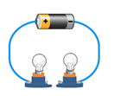
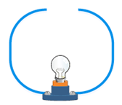
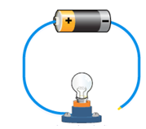
Electrical circuits
5 a day revision
Explain what is meant by current.
A
B
C
D
For each of the circuits A-D say whether it will work. If it doesn’t, explain why.
A
B
C
Describe how a central heating system could be used as a model for an electric circuit.
You should refer to a pump/boiler, water, pipes and radiators in your answer.
Explain why it is harder to locate a broken bulb in a set of bulbs that are connected in series rather than in parallel.
What type of circuits are shown in the diagram?
Which circuit has the highest resistance?
Which circuit has the highest current?
Which circuit has the dimmest bulbs?
Where is current used up most?
@aegilopoides

