Slide 1
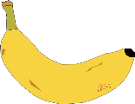
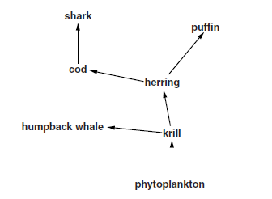
5 a day revision
Ecology
Competition
Give three things plants compete for in an ecosystem.
Why might heart valves need to be replaced?
What is the difference between abiotic and biotic factors? Give 4 examples of each.
Define: habitat, population, community and ecosystem.
Describe 3 possible consequences of removing cod from this food web.
Explain why some ecosystems are described as stable. Use the rainforest as an example to illustrate your answer.

Slide 2
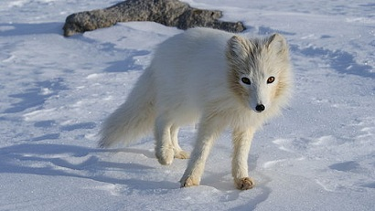
5 a day revision
Ecology
Adaptation
Some microorganisms are known as extremophiles. Explain what this means and give an example of the kind of conditions they can live in.
Why might heart valves need to be replaced?
What are adaptations?
Adaptations can be structural, behavioural or functional. Give an example of each.
Arctic foxes live in very cold conditions. Explain how 2 adaptations that the foxes have help them survive these conditions.
Tropical and desert plants have different densities of stomata. Explain why.

Slide 3
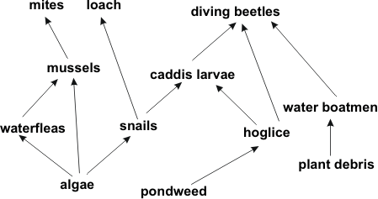
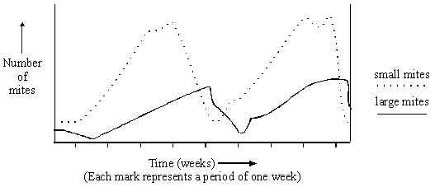
5 a day revision
Ecology
Foods chains
Why might heart valves need to be replaced?
What is shown by a food chain?
What is interdependence?
From this food web give identify the following: producer, primary consumer, secondary consumer, tertiary consumer, predator, prey.
Food webs are often used rather than food chains to show feeding relationships between organisms. Explain why this is an advantage.
leaves → small mites → large mites
What happens to the number of small mites as the number of large mites increases? Explain why.

Slide 4
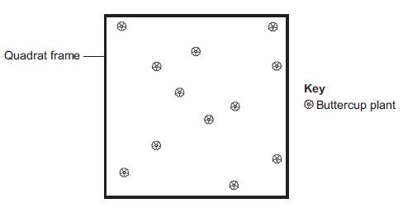
5 a day revision
Ecology
Using quadrats
A grassy field on a farm measured 120m by 80m.
A student wanted to estimate the number of buttercup plants growing in the field.
The student found an area where buttercup plants were growing and placed a 1 m × 1 m quadrat in one position in that area.
The student said, 'This result shows that there are 115 200 buttercup plants in the field.‘ How did they calculate this figure?
What is a transect?
What is a quadrat?
Sunlight is one environmental factor that might affect the distribution of the buttercup plants. Explain why and suggest three other environmental factors that might affect the distribution of the buttercup plants.
How would you improve the student’s method to give a more accurate estimate?

Slide 5
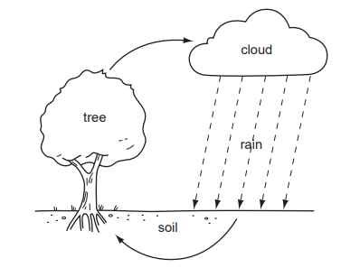
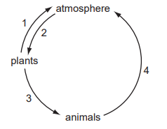
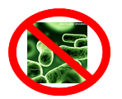
5 a day revision
Ecology
Water and carbon cycle
The diagram shows a simple water cycle. What process is responsible for water loss from the tree?
Give 2 ways that carbon can be returned to the air.
How is carbon passed between animals in the carbon cycle?
The diagram shows part of the carbon cycle. Which numbers represent excretion?
If there were no microorganisms, what impact would this have on the carbon cycle?

Slide 6
5 a day revision
Ecology
Biodiversity and waste management
Why is the amount of waste we produce increasing?
Name 3 types of waste produced by people.
Define:
Biodiversity
Explain why it is preferable to reduce the amount of packaging, even if it is biodegradable.
As human population increases, biodiversity decreases. Explain why and suggest why this is a problem.

Slide 7
5 a day revision
Ecology
Global warming
Give 3 examples of human activities that contribute to global warming.
Why might heart valves need to be replaced?
What is global warming?
Which gases are involved in global warming?
Explain how global warming could affect biodiversity.
Explain how global warming could lead to the loss of low-lying habitats.

Slide 8
5 a day revision
Ecology
Deforestation and land use
Why might heart valves need to be replaced?
What is peat and how is it used?
What is deforestation?
Give 4 ways in which humans are using more land.
Use of fertilisers in agriculture can lead to eutrophication of surrounding water ways. Describe and explain how the process of eutrophication happens.
Explain the impact of deforestation.

Slide 9
5 a day revision
Ecology
Maintaining ecosystems and biodiversity
How do hedgerows increase biodiversity?
Why might heart valves need to be replaced?
How do breeding programmes help endangered species?
What is regeneration?
Explain why it is important to protect biodiversity.
Tensions sometimes exist between conserving a natural ecosystem and the needs of local people. Suggest why.

