Slide 1
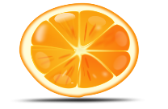
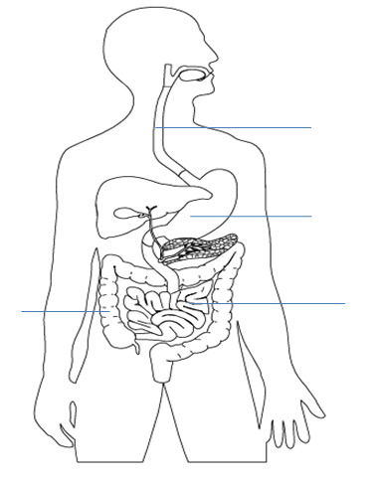
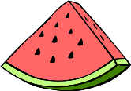
5 a day revision
Digestion
Describe 3 things that happen in the mouth when food is chewed.
Label:
In terms of particles describe the main function of digestion.
A
B
C
D
What is peristalsis?
Describe and explain the adaptations of the small intestine.
@aegilopoides

Slide 2
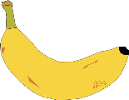
Digestion
5 a day revision
Give an example of a deficiency disease including the main symptoms and the cause.
Fibre isn’t digested by the body. What is it used for?
Name the 5 nutrient groups.
Food | Protein (per 100g) | Carbohydrate (per 100g) | Fat (per 100g)
A | 23.8 | 0.0 | 1.0
B | 13.2 | 65.6 | 2.0
Describe the food tests for starch, protein, sugar and fat.
One of the foods in the table is pasta and the other is chicken. Which is which? Explain your answer.
Suggest why you couldn’t live on these food types alone.
@aegilopoides

