Slide 1
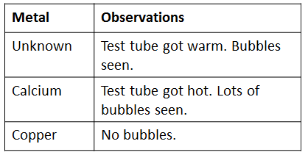
Chemical reactions
5 a day revision
A student wanted to prove that carbon dioxide was produced during a reaction between hydrochloric acid and sodium carbonate. Describe how they could do this.
Describe the differences between chemical and physical changes and give an example of each.
What is the chemical word for burning?
Write the word equation for Magnesium burning in air.*
A student compared the reactivity of different metals with an acid. Use the results in the table to compare the reactivity of the unknown metal with Calcium and Copper. Explain your answer.
Which gas was produced?
How could you prove it?
Draw a diagram to show the fire triangle and use it to explain why each of the following puts out a fire.
Turning off a Bunsen burner
Pouring water onto a fire
Putting a fire blanket over a fire.
* Think about what the Magnesium is reacting with.
@aegilopoides

