Slide 1
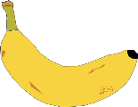
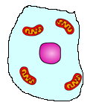
Cells
5 a day revision
Label the cell:
What type of cell is it?
Give 3 differences between a plant cell and an animal cell.
How do we view cells?
Complete the table:
Measure the width of the cell. How big is it in real life?
Part of cell | Function
A | Controls cell activities
Cell membrane | B
C | Where chemical reactions happen
Cell wall | d
Magnification x1000
@aegilopoides

Slide 2
Cells
5 a day revision
Describe how ciliated cells are adapted to their function.
Palisade cells are packed with chloroplasts. What are they for?
What does specialised mean?
How is a root hair cell adapted to do its job?
Muscle cell, palisade cell, root hair cell.
Which is the odd one out? Why?
Is there more than one right answer?
@aegilopoides

