Slide 1
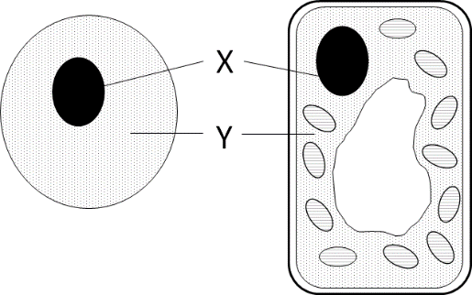
5 a day revision
Cell Biology - Cells
Give 2 differences in structure between prokaryotic and eukaryotic cells.
Respiration is a characteristic of living organisms. State 4 others.
The diagram shows a typical animal cell and typical plant cell. Name X and Y. Name and label another structure found in both cells.
Complete the table.
What features do plant cells have that animal cells do not?
Part of plant cell | Function
Cell membrane
Cell wall
Cytoplasm
Mitochondrion
Nucleus

Slide 2
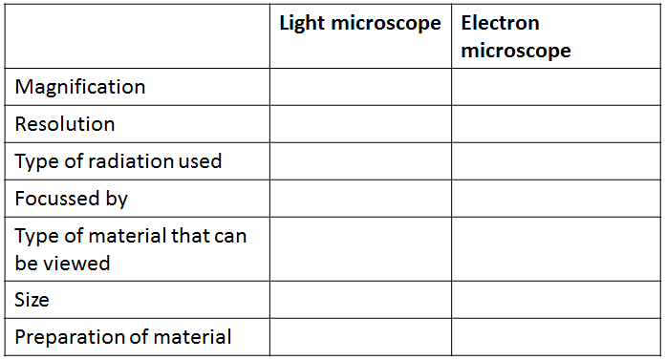
5 a day revision
Cell Biology
Microscopy
Explain why you might add a stain to a sample on a microscope slide.
Why might heart valves need to be replaced?
Why do we use microscopes?
Recall the formula for calculating the magnification of an image.
Describe the method you would use to prepare a slide of onion skin.

Slide 3
5 a day revision
Cell Biology
Cell specialisation
Describe how sperm cells, nerve cells and muscles cells are specialised.
What is differentiation?
Describe how a root hair cell is specialised.
Xylem and phloem are specialised plant cells. Explain why they contain very few subcellular structures.
Why is cell specialisation important for the development and growth of a healthy baby from a fertilised egg?

Slide 4
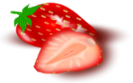
5 a day revision
Cell Biology
Stem cells
What name is given to the parts of plants where mitotically active cells are found?
Explain the difference between embryonic and adult stem cells.
What name is given to the process of stem cells becoming specialised?
What are the potential applications of stem cells in medicine?
Scientists are able to reprogram adult cells so that they behave like embryonic stem cells. Explain why the use of these cells would be less controversial that the use of embryonic stem cells.

Slide 5
5 a day revision
Cell Biology
Mitosis
What happens to the genetic material before the cell divides?
What are the main processes in the cell cycle?
What is mitosis?
For a baby to grow, its cells must develop in a number of ways.
Explain how the process of cell division by mitosis is an important part of the growth process.
The nucleus of a cell contains 2 pairs of chromosomes. Draw a diagram to show the daughter cells produced after mitosis.

Slide 6
5 a day revision
Cell Biology
Diffusion/Osmosis/Active transport
Carbon dioxide and oxygen are exchanged between alveoli and nearby capillaries. Which process is taking place?
Define diffusion. How is osmosis different?
Compare and contrast diffusion and active transport.
Plant roots absorb water mainly by osmosis. Plant roots absorb ions mainly by active transport.
Explain why roots need to use the two different methods to absorb water and ions.
The 4 cells contain different concentrations of glucose. Draw a series of arrows to show how water will move by osmosis between the cells.
0.1%
10%
2%
5%

Slide 7
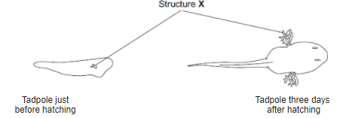
5 a day revision
Cell Biology
Exchange surfaces
Why might heart valves need to be replaced?
Give 3 adaptations of exchange surfaces that increase the efficiency of diffusion.
Describe how the surface of the small intestine is maximised for absorption.
Name 3 substances that can diffuse through cell membranes.
The drawings show a tadpole just before hatching and three days after hatching.
The average number of alveoli in each human lung is 280 million.
The average surface area of 1 million alveoli is 0.25 m².
Calculate the total surface area of a human lung.
Structure X helps in the exchange of substances between the tadpole and the water.
Suggest how the development of structure X in the tadpole help it to survive as it grows larger.

