Slide 1
Using a light microscope to observe and record animal and plant cells.
Write an equipment list for looking at cheek cells with a microscope. State why each piece of equipment is needed.
Why does the layer of specimen cells need to be thin?
Why do we stain the specimen cells?
Why does the coverslip have to be applied carefully
What sub-cellular structures are likely to be observed using a light microscope?
Why is a slide viewed with low power first?
What is the highest magnification for the light microscope?
How is the actual size of a cell structure determined from microscope measurements?
What precautions are needed when preparing a microscope slide?

Slide 2
Use qualitative reagents to test for a range of carbohydrates, lipids and proteins.
State the reagents that are used to test for carbohydrates (sugar and starch), protein and lipids (fats).
Describe the positive result for each test.
Describe how a solution of the food sample can be prepared.
Identify the safety precautions for each test.
How can cross contamination of samples be avoided?
Explain why water could be used as a control for the food tests.
What is the difference between qualitative and quantitative? Why is the Benedict’s test described as semi-quantitative?

Slide 3
Investigate the effect of a range of concentrations of salt or sugar solutions on the mass of plant tissue.
What are the independent and dependent variables in this investigation?
Why do the potato strips have to be blotted dry?
Why should the potato strips be left in the solutions for at least 15 minutes?
What are the main sources of errors in this procedure?
Why is percentage change in mass rather than just change in mass calculated?
How can you use a graph to calculate the concentration of the potato cells?
What safety precautions are used in the practical?

Slide 4
Investigate the effect of pH on enzyme activity.
Why is iodine solution used?
Why are syringes used to measure the volumes of the solutions?
Why is the timer started after the starch solution is added?
Why must the syringes be used in the same solutions when the investigation is repeated?
What are the main errors in this procedure? How could you improve it?
What other factors could have affected the results?
How is the rate of reaction being measured?
What safety precautions are used in the practical?
How could you improve the validity of results?

Slide 5
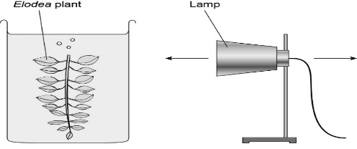
Investigate the effect of light intensity on the rate of photosynthesis using an aquatic organism such as pondweed.
Use the diagram above to identify the independent and dependent variables in this experiment. State 2 control variables.
Describe how the inverse square law can be used to calculate light intensity.
Explain why counting bubbles is not the best way to measure the rate of photosynthesis.
Suggest a way of improving the validity of the result.
Explain how the temperature could be controlled in this experiment and why it is important.
What safety precautions should you be aware of doing this experiment?

Slide 6
Plan and carry out an investigation into the effect of a factor on human reaction time.
State two factors that can affect reaction time.
Describe how to use the ruler drop test to investigate reaction time.
Identify two improvements to the method to improve the validity of the results.
Why is the experiment repeated?
Suggest why a computer method for measuring reaction time may be better than the ruler drop method.

Slide 7
Measure the population size of a common species in a habitat.
State 3 environmental factors that could affect the distribution of a plant species in a habitat.
Describe how a quadrat could be used to investigate the distribution of a plant species in two areas.
Why is it important that the quadrats are placed randomly?
Suggest why a transect may be used when investigating distribution.
Explain how you could use the mean value of plants in a quadrat to estimate the population in an area.

