Slide 1
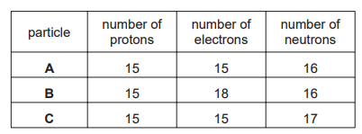
5 a day revision
Atomic structure and the Periodic Table
Atoms, Elements and Compounds
What information can be gained from the atomic number and the mass number of an element?
Define: element, compound, isotope.
State the 3 sub-atomic particles, where they are found, their charge and mass.
Predict the formulae of the following compounds:
Barium oxide
Boron oxide
What is the evidence in the table for each of the following?
Particle A is an atom.
A, B, and C are all the same element.
B is a negative ion.
A and C are isotopes.
Is this element a metal or a non-metal? Explain your answer.

Slide 2
5 a day revision
Atomic structure and the Periodic Table
Formulae, equations and RFM
Iron forms an oxide with the formula Fe₂O₃. What is the RFM of this compound?
Hydrogen and oxygen are formed in a reaction where water splits apart. Give a word equation and a balanced symbol equation.
Why is it important to balance equations?
The formulae of compounds W, X and Y are shown.
W:CuSO₄.5H₂O
X: MgSO₄.7H₂O
Y: Cu(NO₃)₂.6H₂O
Which statement is correct?
A. W contains twice as many hydrogen atoms as oxygen atoms.
B. X contains the most oxygen atoms.
C. Y contains the most hydrogen atoms.
D. Y contains the same number of hydrogen and oxygen atoms.
Balance:
CH₄ + O₂ → CO₂ + H₂0
Ca + H₂O → Ca(OH)₂ + H₂
Ca(NO₃)₂ + Na → NaNO₃ + Ca
K + H₂O → KOH + H₂

Slide 3
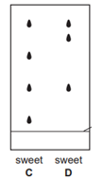
5 a day revision
Atomic structure and the Periodic Table
Separation techniques
Choose the most suitable technique to separate:
Water from sea-water
Iron filings from a mixture of iron filings and water
Ethanol from a mixture of ethanol and propanol
A blue solid is soluble in water. What method could be used to obtain the pure solid from an aqueous solution?
A mixture of ethanol and methanol are separated by fractional distillation. This method depends on a difference in property X of these two alcohols. What is X?
Describe how to produce a sample of copper sulfate crystals from copper oxide. You should include details of the equipment, method and safety precautions.
What method of separation is used to separate the colours present in some fruit sweets?
The results obtained for the colours in 2 different sweets, C and D, are shown. What conclusions can you draw about the colours present in sweets C and D?

Slide 4
5 a day revision
Atomic structure and the Periodic Table
History of the atom
Describe the ‘plum-pudding model’ of the atom.
Compare the position of the subatomic particles in the plum-pudding and nuclear
models.
Match the scientists and their ideas.
Explain how evidence from Rutherford’s gold foil experiment disproved the plum-pudding model.
The neutron was the last subatomic particle to be discovered. Suggest a possible reason for this.

Slide 5
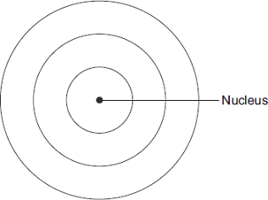
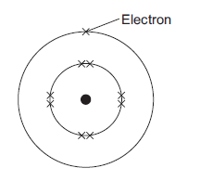
5 a day revision
Atomic structure and the Periodic Table
Electronic structure
In terms of their electronic structure state why lithium and sodium are both in Group 1.
How many electrons are allowed in the 1st, 2nd and 3rd shells?
Give the electronic structure of aluminium (atomic number = 13)
Complete the diagram to show the electronic structure of an aluminium atom.
The electronic structure of a neon atom shown is not correct. Explain why.

Slide 6
5 a day revision
Atomic structure and the Periodic Table
The Periodic Table
How did Mendeleev organise his periodic table?
How are elements arranged in the modern periodic table?
Where are metals found in the Periodic table?
Sodium readily forms 1+ ions. Suggest what ions potassium forms and explain why.
Why did Mendeleev leave gaps in his periodic table?

Slide 7
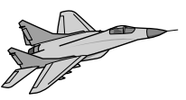
5 a day revision
Atomic structure and the Periodic Table
Metals, non-metals and transition metals
How can you tell that copper is a transition metal and aluminium is not a transition metal from the position of each metal in the periodic table?
What kind of ions do metals form?
Give 3 properties of metals and 3 properties of non-metals.
The table gives information about the properties of some metals.
Give 3 properties specific to transition metals.
Only a small number of military aircraft like the one shown are made. Evaluate the advantages and disadvantages of each metal for making the body and wings of this aircraft. Which metal would you choose and why?

Slide 8
5 a day revision
Atomic structure and the Periodic Table
Group 1, 7 and O
Give the general equations for the reactions of group 1 metals with:
- water
- chlorine
- oxygen.
Give 4 examples of elements in:
Group 1
Group 7
Group 0
What kind of compounds are formed by group 1 elements?
Compare the reactivity of elements in Group 1 and Group 7 as you moved down the group. Explain the difference.
Sodium and chlorine are both reactive. Argon is unreactive. Explain why.

Slide 9
5 a day revision
Atomic structure and the Periodic Table
More Group 1, 7 and O
Why do Group 0 elements exist as monoatomic gases?
What are the alternative names for Group 1 Group 7 and Group 0?
State the trends in reactivity, atomic mass and melting/boiling points for Group 7 elements?
Predict whether bromine will displace iodine from sodium iodide. Explain why.
Explain why the boiling point of Group 0 elements increases as you move down the group.

